Slide 1
Pizza Sales Analysis
HNG Data Analytics Track0
NAME: Adegbiran-Ayinoluwa Ifeoluwa Eniola
Dataset Source:Kaggle-Pizza_Sales
Date: October 17th 2025
POST: Linkedin-Post

Slide 2
Dataset Overview
Dataset: Pizza Restaurant Sales
Source: Kaggle
Records: 48,620 rows
Columns (12): Pizza Name, Pizza_category, Pizza_size, Quantity, Unit Price, Order_details_id, Order_id, Pizza_id, Order_date, Order_time, Total_price, Pizza_ingredients
Purpose: To analyze pizza sales performance and trends.

Slide 3
Research Questions
Q 1. Which pizza category generated the highest total revenue and number of orders?
Q 2. How do total sales and number of orders vary across months?
Q 3. Which day of the week records the highest number of orders?

Slide 4
Data Cleaning
Verified there were no missing or duplicate records.
Changed the data type of Unit Price and Total Price columns to Currency format for consistency
Added two new columns to enable time-based analysis:
DayName - Extracted the day of the week from each order date using ( Date.DayOfWeekName([order_date]))
MonthName - Extracted the month name from each order date using (Date.MonthName([order_date]))
Checked for duplicates and ensured all date/time were valid.

Slide 5
Exploratory Summary
Metric | Value
Total Revenue | 817860.05
Total Orders | 48620
Average Order Value | 16.82147367
Top Pizza Sold | The Thai Chicken Pizza
Least Pizza Sold | The Brie Carre Pizza

Slide 6
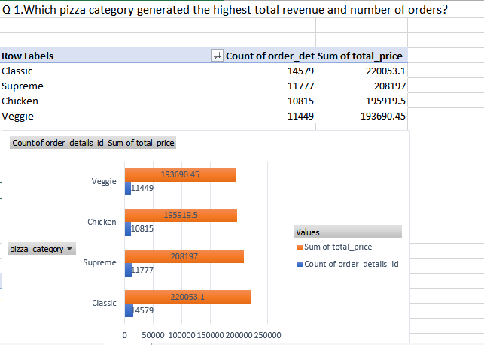
Analysis (Q1): Sales and Order Trends Across Pizza Categories
Purpose: To identify which pizza categories (Classic, Supreme, Veggie, Chicken) drive the most business, both in total income and popularity.
Insight: Classic pizzas may record the most orders, but over time, Supreme pizzas might generate higher total revenue due to higher prices. Seeing how close in total price it is with Classic but far in order count

Slide 7
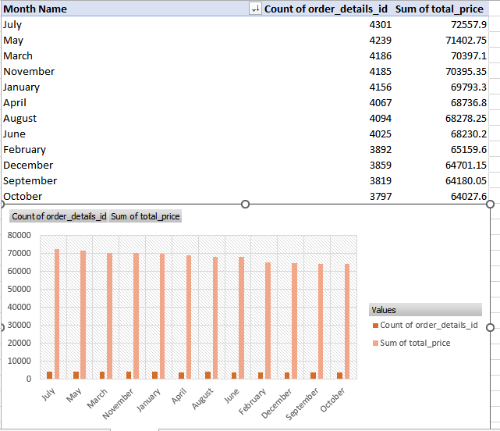
Analysis (Q2): Monthly trends on sales and order count
Purpose: To discover trends and seasonality in pizza demand, useful for inventory and staffing decisions.
Insight: July recorded the highest number of orders and total sales, while October had the lowest. This suggests a strong mid-year demand, possibly due to summer holidays and family activities.
Sales generally remain steady across months with minor seasonal variations.

Slide 8
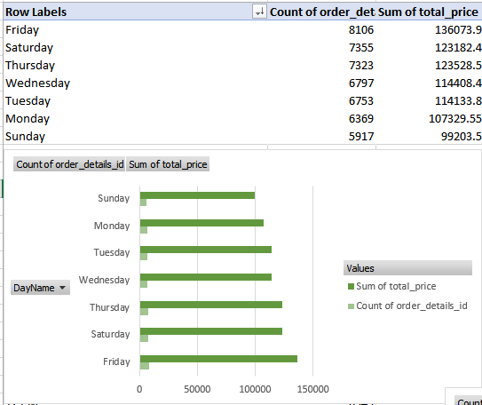
Analysis (Q3): Sales and Orders by Day of the Week
Purpose: To identify the busiest days of operation, useful for scheduling, promotions, and managing workloads.
Insight: Friday and Saturday may be peak days for pizza sales, suggesting higher weekend demand.

Slide 9
Insights & Conclusions
Classic and Supreme pizzas dominate revenue share.
Fridays & Saturdays have higher demand.
It usually busy during lunch and dinner hours
Tomatoes, Red pepper and Red onions are ususally found in most pizzas
Large sized pizzas are ordered the most
It seems the shop opens at 9, but the number of orders at 9 is almost non-existent.
Recommendation: Focus promotions on popular pizzas during peak days.

Slide 10
Limitations & Future Work
Dataset doesn’t include customer demographic
Only covers a limited time period.
Future work:
  Visualize using Power BI for dynamic insights.
  Predict future demand with time series analysis

